Slide 1
Branching
AI2C Tech Intro

Slide 2
Objectives
Utilize branching to manage changes to a git repository
Discuss the different merge strategies
Resolve merge conflicts

Slide 3
Git Review
Repository
Staged vs unstaged
Commit
Diff?

Slide 4
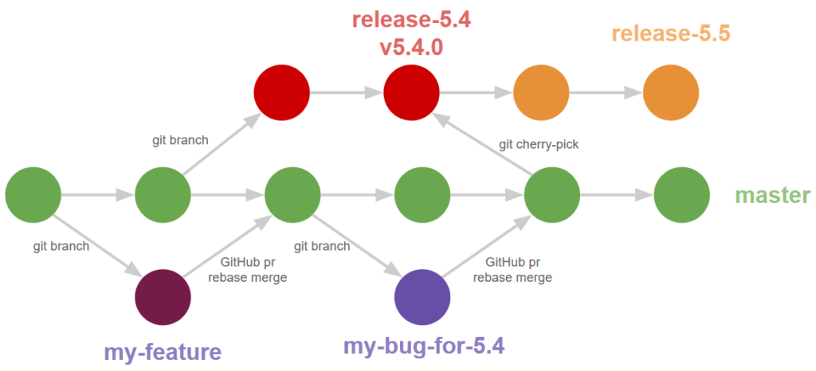
Branches
Repositories are a tree-like structure
Trees have branches
Branches are made off of the trunk, or other branches

Slide 5
Why branch?
Parallel work
Safe experimentation
Protect the main branch

Slide 6
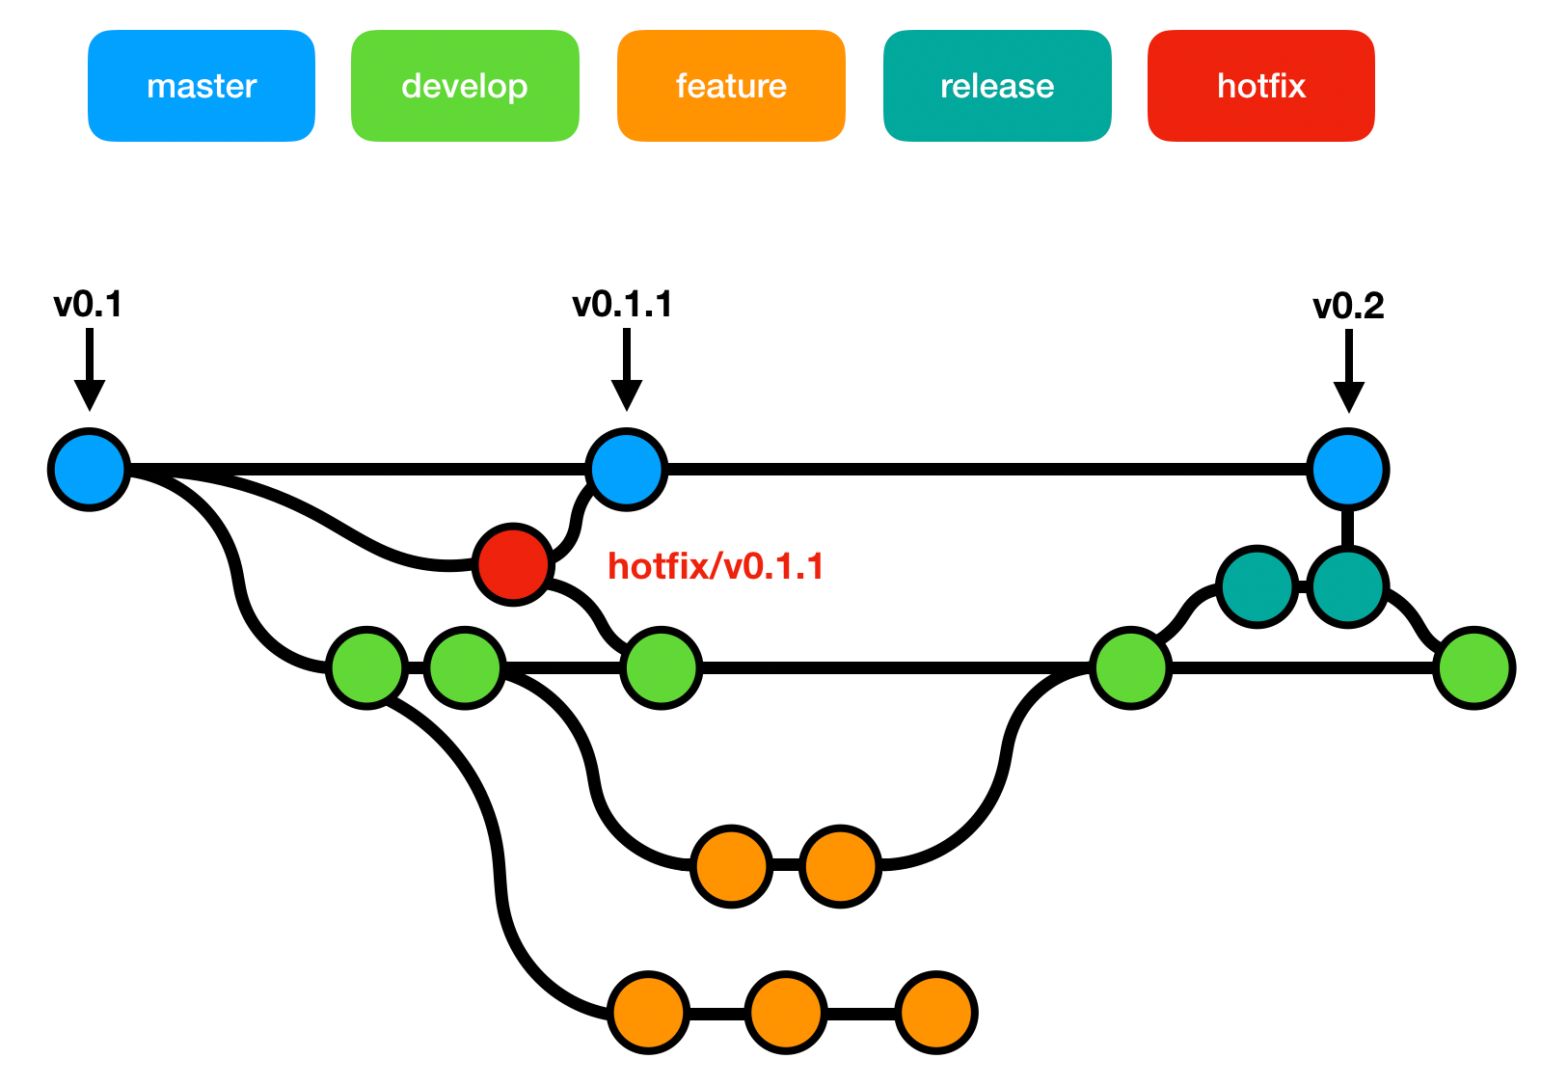
“Normal” branches
Main
Develop
Feature
Bugfix
Release
Hotfix

Slide 7
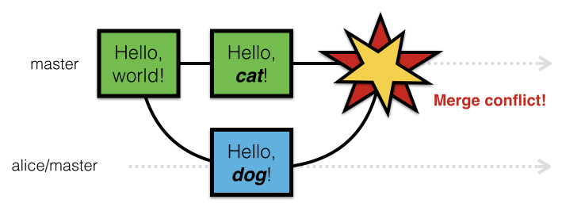
Conflicts

Slide 8
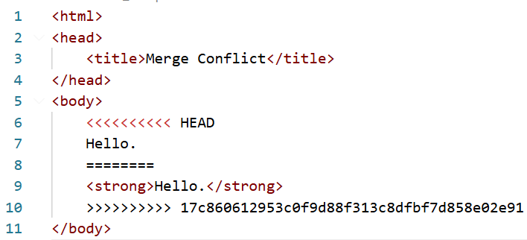
Reading Conflicts (They’re not scary)

Slide 9
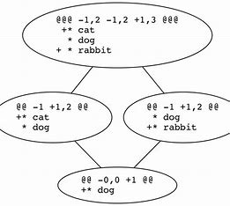
After resolving?
Git add / commit

Slide 10
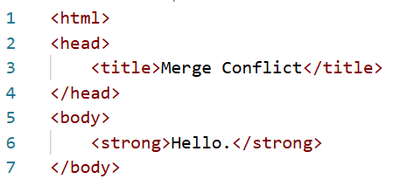
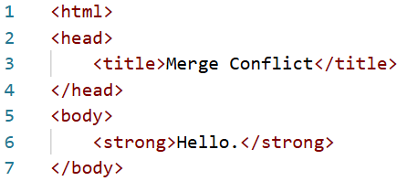
Reading Conflicts (Resolution)

Slide 11
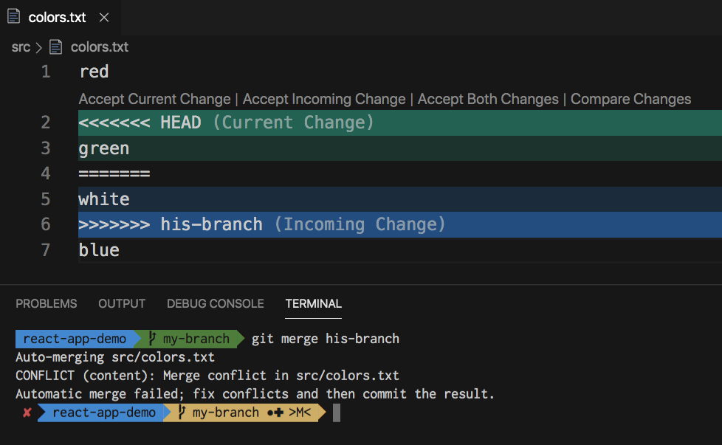
Reading Conflicts (Pretty Colors)

Slide 12
Hands-On #1
Make and merge branches
Resolve conflicts

Slide 13
Viewing Branches
Git for Windows has tig built-in
VS Code has branch visualization extensions

Slide 14
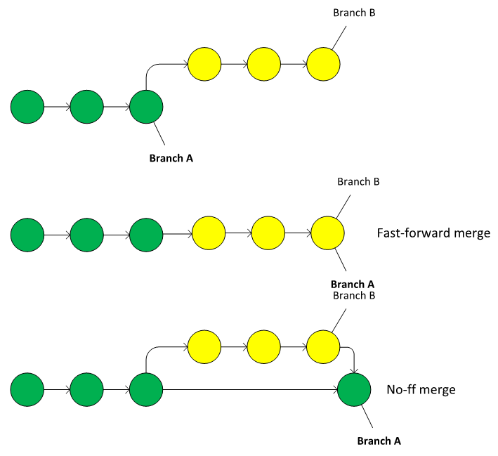
Merging Strategies
Fast-forward applies all commits onto the other branch
--no-ff keeps the branch history and creates a merge commit with all changes
--squash
Notes:
https://lukemerrett.com/different-merge-types-in-git/

Slide 15
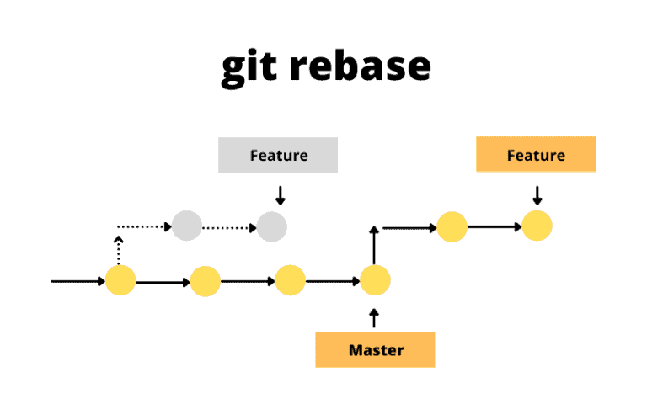
Rebasing

Slide 16
One strategy (feature branch)
git fetch
git rebase main
git checkout main
git merge --squash feature-a
git commit -m “feature-a”

Slide 17
Hands-On #2
Visualize different merging strategies

